Slide 1
Stronger Mixed-Size Placement Backbone Considering Second-Order Information
Yifan Chen, Zaiwen Wen, Yun Liang, Yibo Lin
Peking University, China
Presenter : Min-Feng Hsieh
Adviser : Ting-Chi Wang

Slide 2
Outline
Introduction
Preliminaries
Proposed Algorithm
Previous methods
Barzilai-Borwein Method Enabled Nesterov Algorithm
Macro Legalization
Experimental Result

Slide 3
Outline
Introduction
Preliminaries
Proposed Algorithm
Previous methods
Newton method
Barzilai-Borwein Method Enabled Nesterov Algorithm
Macro Legalization
Experimental Result

Slide 4
Introduction
Macro placement significantly effects the eventual quality of the placement result.
Existing analytical placement algorithm may fail if the parameter is not well-tuned.
Some mixed-size placement algorithms leverage mathematical optimization.
mPL6, NTUplace, ePlace-MS
Some research focuses on efficient data structures to represent a macro placement.
CG, MP-tree, CP-tree

Slide 5
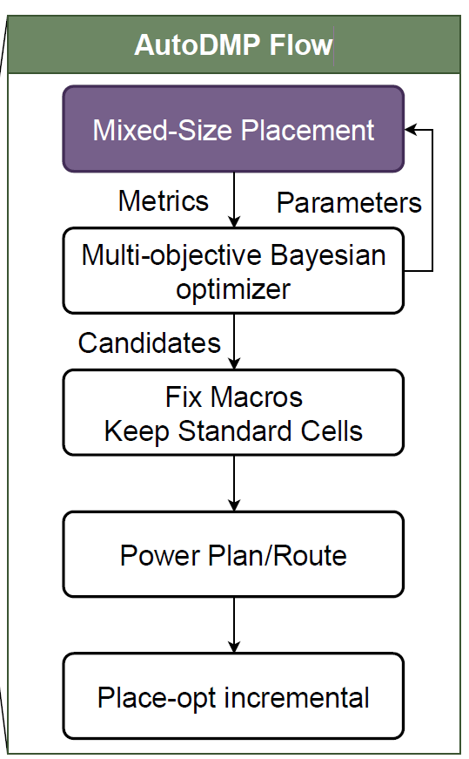
Introduction
Some machine learning techniques have also been proposed.
Macro placement solutions based on routability prediction.
Graph learning based initialization for mixed-size placement.
Reinforcement learning for macro refinement.
AutoDMP apply DREAMPlace to performs hyper-parameter searching upon a mixed-size placement.
Considering the congestion and the WL.

Slide 6
Introduction
The macros’ motion will cause drastic changes in the gradient due to their heterogeneous sizes.
Most mixed-size placement algorithms rely on first-order gradient information
This paper aim to address the convergence issue by considering second-order

Slide 7
Outline
Introduction
Preliminaries
Proposed Algorithm
Previous methods
Barzilai-Borwein Method Enabled Nesterov Algorithm
Macro Legalization
Experimental Result

Slide 8
Analytical Mixed-Size Placement
Including three stages:
Global placement
Legalization
Detail placement
Notes:
GR: 將instance分散到layout中
Legalization: 將instance中的overlap消除並且進行alignment
DR: further improve the quality

Slide 9
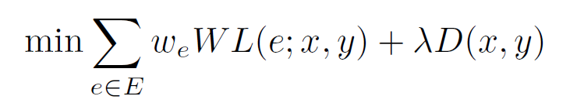
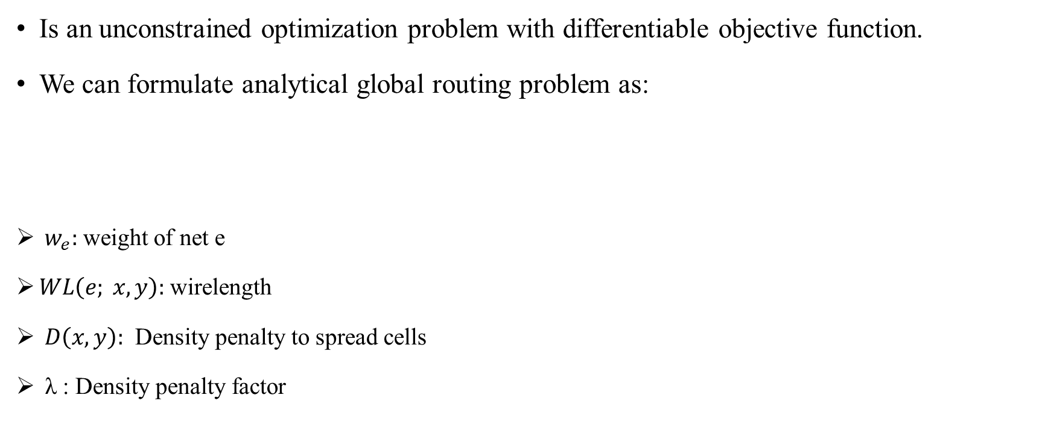
Analytical Mixed-Size Placement
Is an unconstrained optimization problem with differentiable objective function.
We can formulate analytical global routing problem as:
${ w}_{e}:$ weight of net e
$WL\left(e; x, y\right):$wirelength
$D\left(x, y\right):$ Density penalty to spread cells
λ : Density penalty factor

Slide 10
Macro Legalization
Legalization stage will ensure non-overlapping with minimum displacement.
The legalization will be divided into two parts:
Macro legalization
Instance legalization
Mainly focus on macro legalization in this paper.

Slide 11
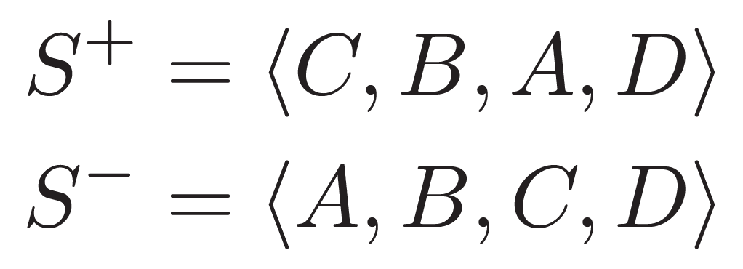
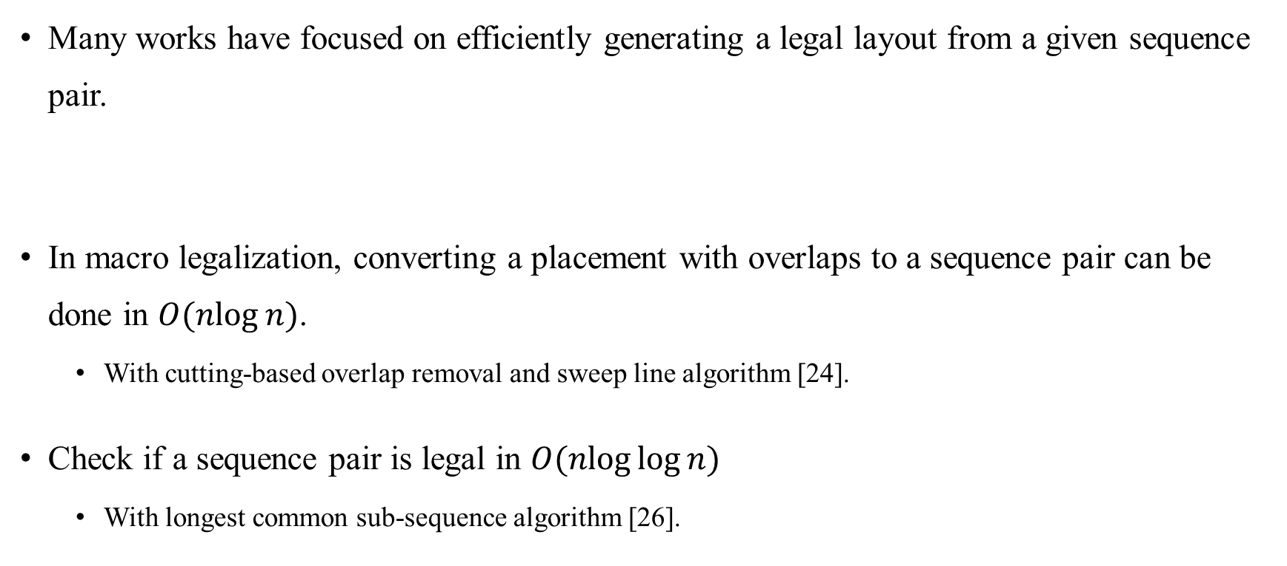
Sequence Pair
Many works have focused on efficiently generating a legal layout from a given sequence pair.
In macro legalization, converting a placement with overlaps to a sequence pair can be done in $O(nlog⁡n)$.
With cutting-based overlap removal and sweep line algorithm [24].
Check if a sequence pair is legal in $O(nlog⁡log⁡n)$
With longest common sub-sequence algorithm [26].

Slide 12
Outline
Introduction
Preliminaries
Proposed Algorithm
Previous methods
Barzilai-Borwein Method Enabled Nesterov Algorithm
Macro Legalization
Experimental Result

Slide 13
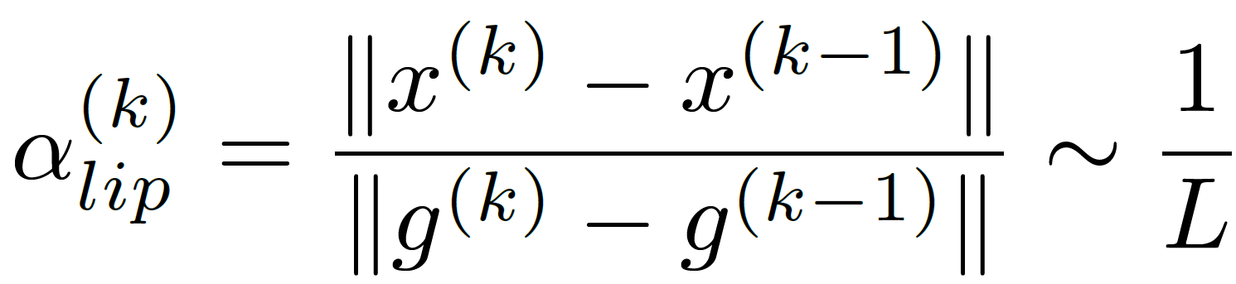
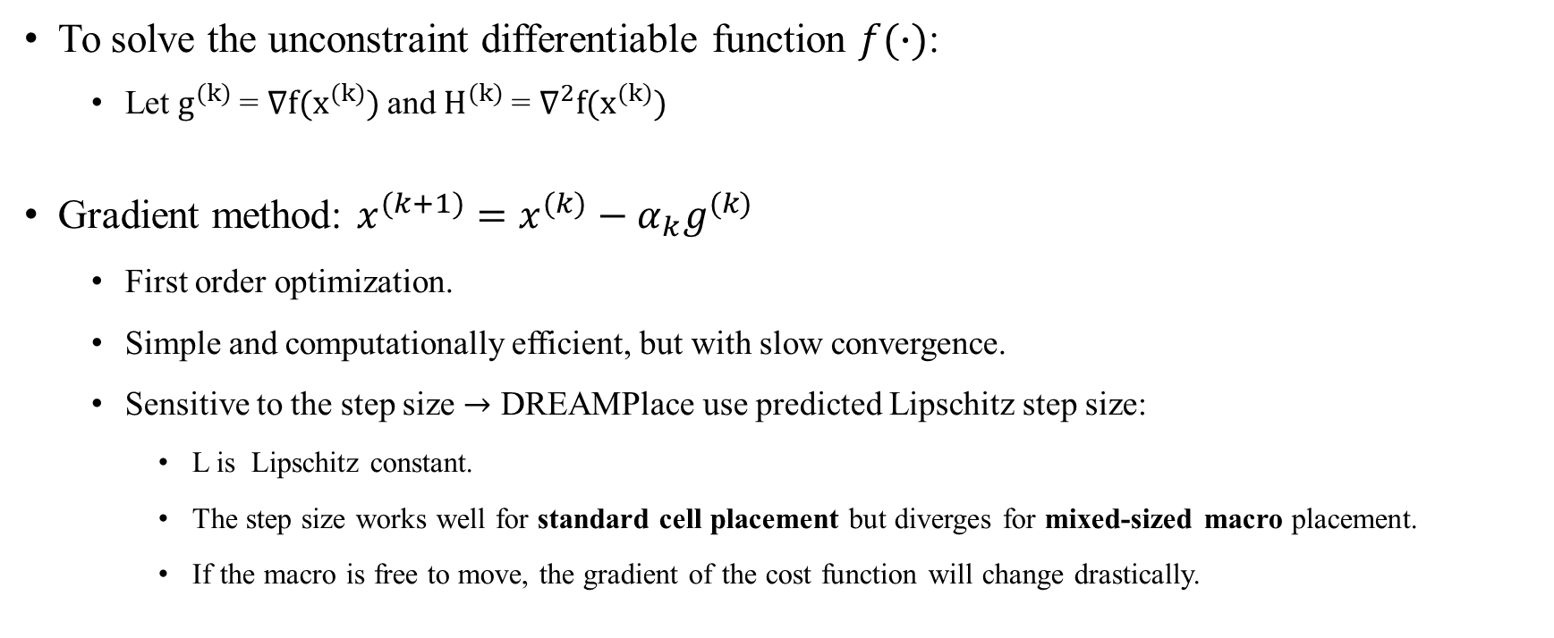
Gradient method
To solve the unconstraint differentiable function $f(∙)$:
Let $g^{(k)}$= $∇f(x^{(k)})$and $H^{(k)}$= $∇^{2}f(x^{(k)})$
Gradient method: $x^{(k+1)}=x^{(k)}−α_{k}g^{(k)}$
First order optimization.
Simple and computationally efficient, but with slow convergence.
Sensitive to the step size $→$ DREAMPlace use predicted Lipschitz step size:
L is Lipschitz constant.
The step size works well for standard cell placement but diverges for mixed-sized macro placement.
If the macro is free to move, the gradient of the cost function will change drastically.

Slide 14
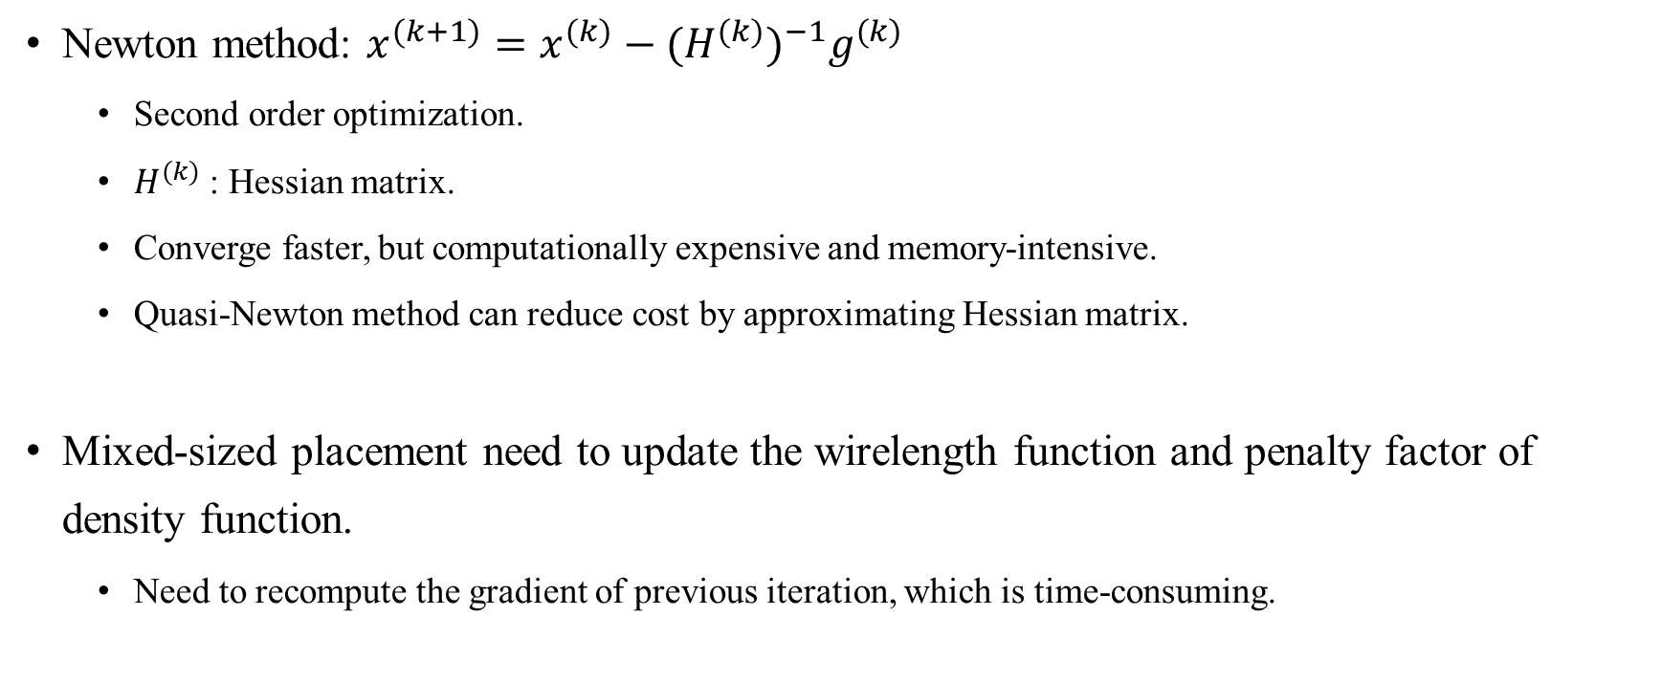
Newton method
Newton method: $x^{(k+1)}=x^{(k)}−{{(H}^{(k)})}^{−1}g^{(k)}$
Second order optimization.
$H^{(k)}$: Hessian matrix.
Converge faster, but computationally expensive and memory-intensive.
Quasi-Newton method can reduce cost by approximating Hessian matrix.
Mixed-sized placement need to update the wirelength function and penalty factor of density function.
Need to recompute the gradient of previous iteration, which is time-consuming.
Notes:
* but computationally expensive and memory-intensive: 因為要算hessian matrix
* Wirelength function可以用weighted-average或是log-sum-exp

Slide 15
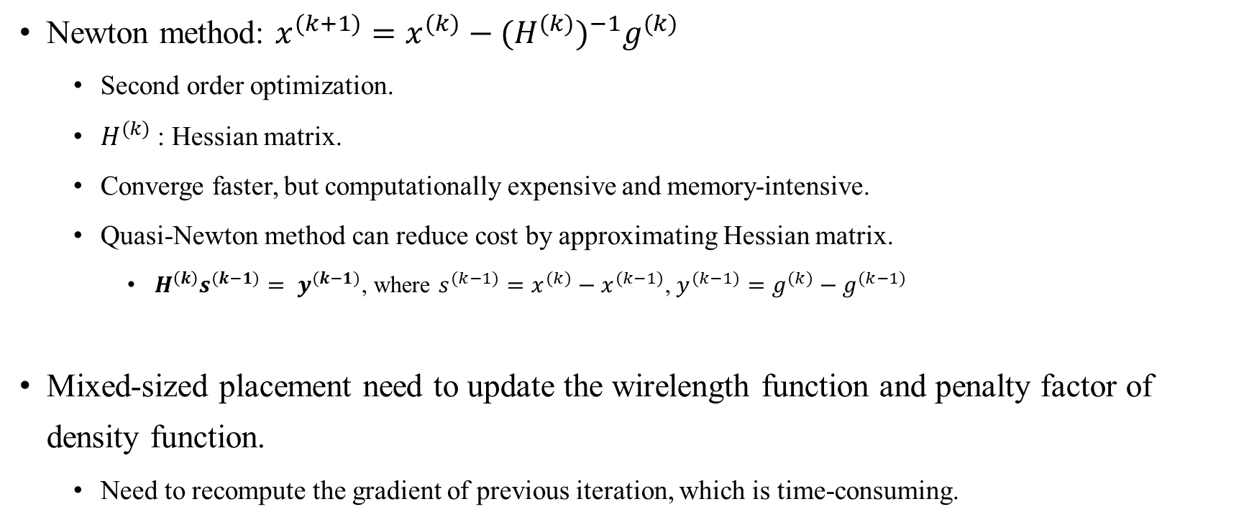
Newton method
Newton method: $x^{(k+1)}=x^{(k)}−{{(H}^{(k)})}^{−1}g^{(k)}$
Second order optimization.
$H^{(k)}$: Hessian matrix.
Converge faster, but computationally expensive and memory-intensive.
Quasi-Newton method can reduce cost by approximating Hessian matrix.
$H^{\left(k\right)}s^{(k−1)}= y^{(k−1)}$, where $s^{(k−1)}=x^{(k)}−x^{(k−1)}$, $y^{(k−1)}=g^{(k)}−g^{(k−1)}$
Mixed-sized placement need to update the wirelength function and penalty factor of density function.
Need to recompute the gradient of previous iteration, which is time-consuming.
Notes:
* but computationally expensive and memory-intensive: 因為要算hessian matrix
* Wirelength function可以用weighted-average或是log-sum-exp

Slide 16
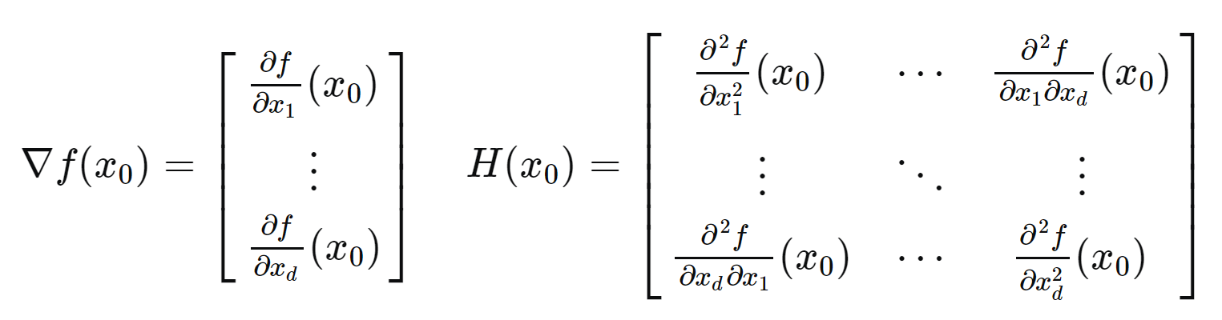

Slide 17
Outline
Introduction
Preliminaries
Proposed Algorithm
Previous methods
Barzilai-Borwein Method Enabled Nesterov Algorithm
Macro Legalization
Experimental Result

Slide 18
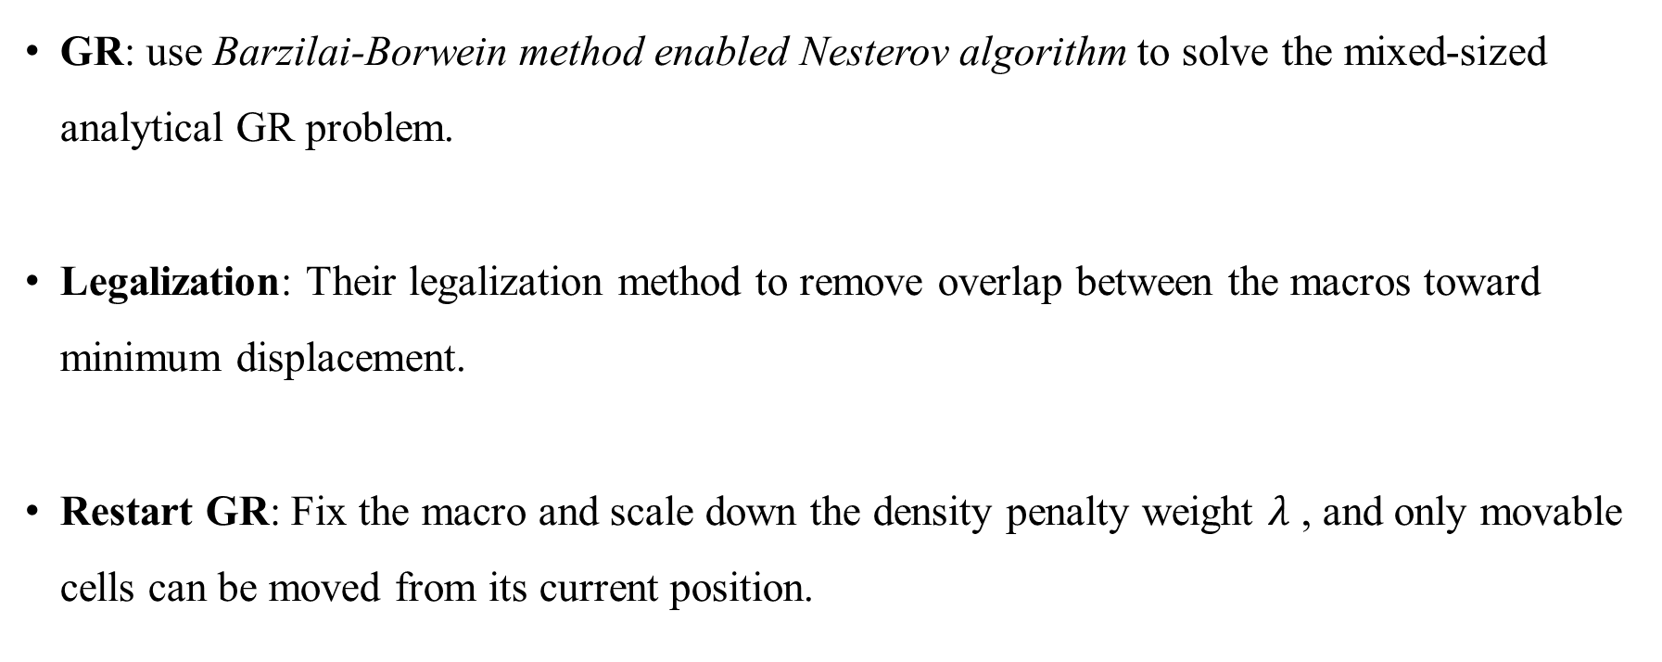
Algorithm
GR: use Barzilai-Borwein method enabled Nesterov algorithm to solve the mixed-sized analytical GR problem.
Legalization: Their legalization method to remove overlap between the macros toward minimum displacement.
Restart GR: Fix the macro and scale down the density penalty weight $λ$ , and only movable cells can be moved from its current position.

Slide 19
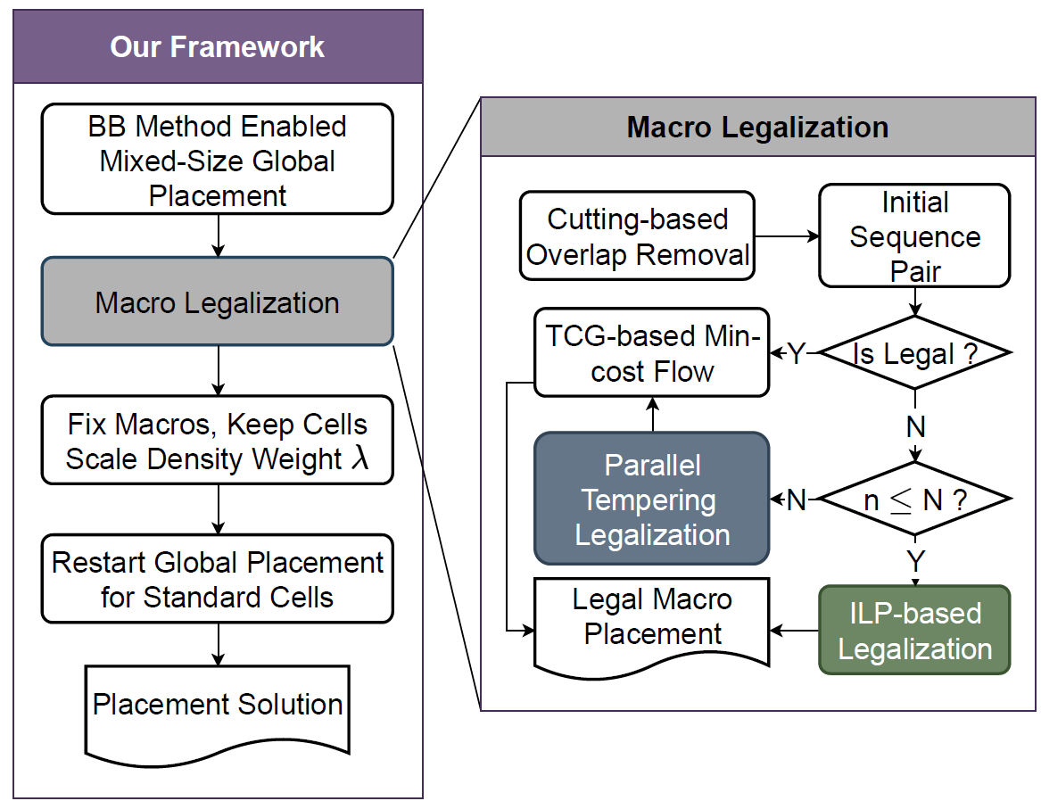
Algorithm

Slide 20
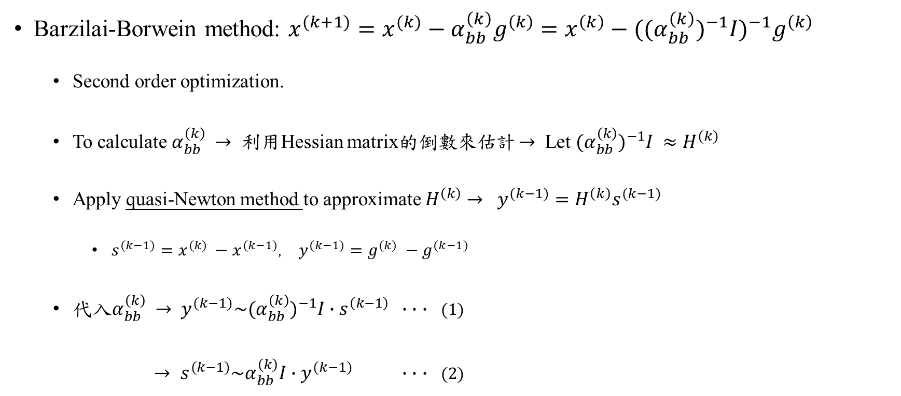
Barzilai-Borwein Method Enabled Nesterov Algorithm
Barzilai-Borwein method: $x^{(k+1)}=x^{(k)}−α_{bb}^{\left(k\right)}g^{\left(k\right)}=x^{\left(k\right)}−{((α}_{bb}^{\left(k\right)})^{−1}I)^{−1}g^{\left(k\right)}$
Second order optimization.
To calculate $α_{bb}^{\left(k\right)} →$ 利用Hessian matrix的倒數來估計 $→$ Let ${{(α}_{bb}^{\left(k\right)})^{−1}I ≈H}^{(k)}$
Apply quasi-Newton method to approximate $H^{\left(k\right)}$ $→$ $y^{(k−1)}=H^{\left(k\right)}s^{(k−1)}$
$s^{(k−1)}={x^{(k)} −x}^{(k−1)}$, $y^{(k−1)}={g^{(k)} −g}^{(k−1)}$
代入$α_{bb}^{\left(k\right)}$ $→$ $y^{(k−1)}\sim {(α}_{bb}^{\left(k\right)})^{−1}I∙s^{\left(k−1\right)}$ $∙$ $∙$ $∙$ (1)
$→ s^{(k−1)}\sim α_{bb}^{\left(k\right)}I∙$ $y^{(k−1)}$ $∙$ $∙$ $∙$ (2)
Notes:
* $y^{(k−1)}=H^{\left(k\right)}s^{(k−1)}$是quasi-newton估計hessian的方式 * 你提到的是正確的，牛頓法（Newton's method）確實使用了近期的梯度信息，但其關鍵區別在於，牛頓法不僅僅使用了梯度信息，還使用了 Hessian 矩陣，即二階導數信息。這是牛頓法區別於一些僅使用梯度信息的優化方法的重要因素。
當目標函數的 Hessian 矩陣具有較強的變化性，特別是在非凸或高度非線性的情況下，牛頓法可能在某些情況下變得不穩定，並且對於動態變化的敏感性增加。原因包括：
高計算成本： 計算和存儲 Hessian 矩陣是相對昂貴的，尤其是在高維度問題中。當 Hessian 矩陣變化劇烈時，需要不斷更新 Hessian 矩陣，這可能變得代價高昂。
數值不穩定性： 在一些情況下，牛頓法可能由於數值上的不穩定性而失效，尤其是在 Hessian 矩陣不正定或接近奇點的情況下。
需要精確的 Hessian 信息： 牛頓法期望能夠獲得準確的 Hessian 信息，而這在一些動態變化的情況下可能難以實現。
相對於這些挑戰，Barzilai-Borwein 方法作為一種擬牛頓法，利用了梯度信息，但同時避免了直接使用 Hessian 矩陣，它通過連續兩次迭代之間的梯度差異來近似 Hessian 矩陣的逆，這使得它相對於牛頓法更容易適應動態變化，同時降低了計算成本。儘管這種逼近可能不如直接使用 Hessian 矩陣那樣準確，但在一些實際應用中，這種權衡可能是合理的。

Slide 21
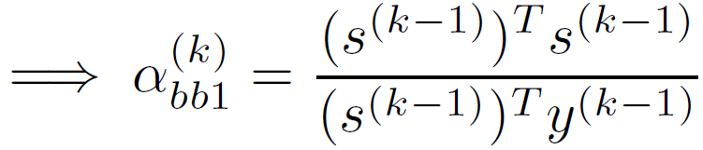
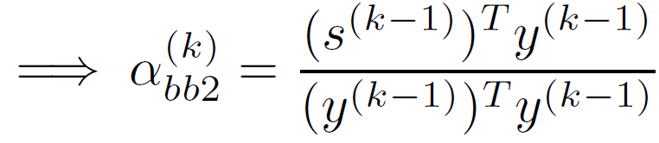
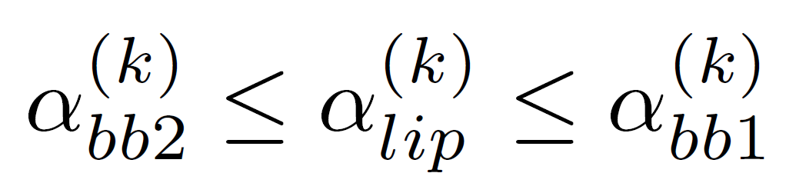
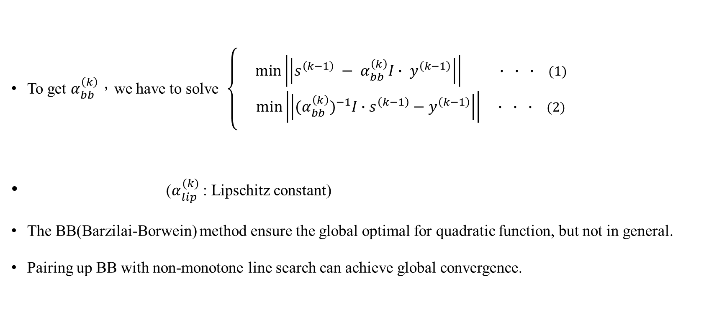
Barzilai-Borwein Method Enabled Nesterov Algorithm
To get $α_{bb}^{\left(k\right)}$，we have to solve $\left\{\begin{aligned}\min\left|\left|s^{\left(k−1\right)} − α_{bb}^{\left(k\right)}I∙ y^{\left(k−1\right)}\right|\right| ∙ ∙ ∙ \text{(1)} \\ \min\left|\left|{(α}_{bb}^{\left(k\right)})^{−1}I∙s^{\left(k−1\right)}−y^{\left(k−1\right)}\right|\right| ∙ ∙ ∙ \text{(2)}\end{aligned}\right.$
($α_{lip}^{(k)}$ : Lipschitz constant)
The BB(Barzilai-Borwein) method ensure the global optimal for quadratic function, but not in general.
Pairing up BB with non-monotone line search can achieve global convergence.
Notes:
* 因為不能保證cost function的單調遞減 (二次函數一定是單調遞減)

Slide 22
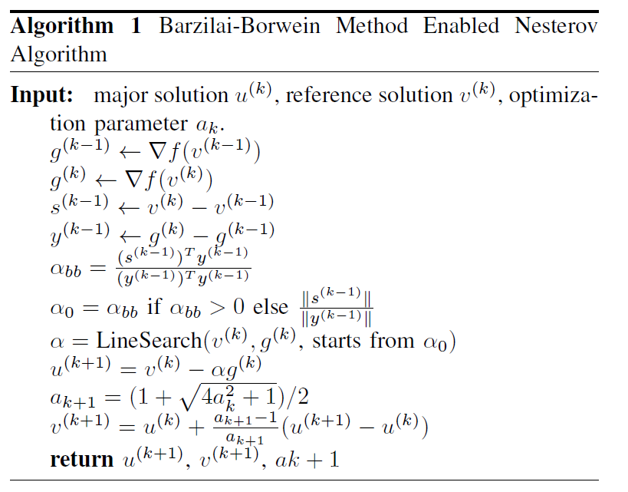
Algorithm
Notes:
line1-2: 計算梯度
Line3-4: 計算步長
Line5: 計算bb method的步長
Line6: 設定起始的位置，並且用Line search去計算最佳的步長
Line7: 更新參考解
Line8-9:更新主要解
Line10: return主要解、參考解和新的優化參數

Slide 23
Outline
Introduction
Preliminaries
Proposed Algorithm
Previous methods
Barzilai-Borwein Method Enabled Nesterov Algorithm
Macro Legalization
Experimental Result

Slide 24
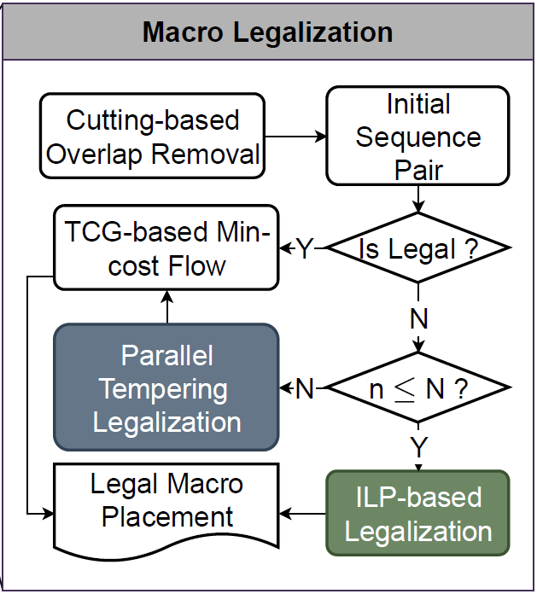
Macro Legalization
First apply Cutting-based Overlap Removal [24] to build the initial sequential pair.
If feasible:
Use transitive closure graph(TCG) based min-cost flow algorithm[24] to obtain macro positions.
If infeasible:
Small problem size: Use ILP-based macro legalization.
Large problem size: parallel tempering based macro legalization.

Slide 25
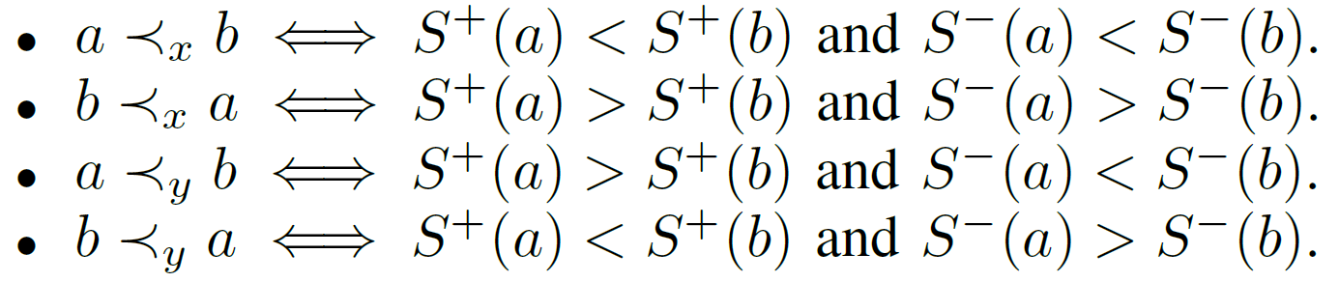
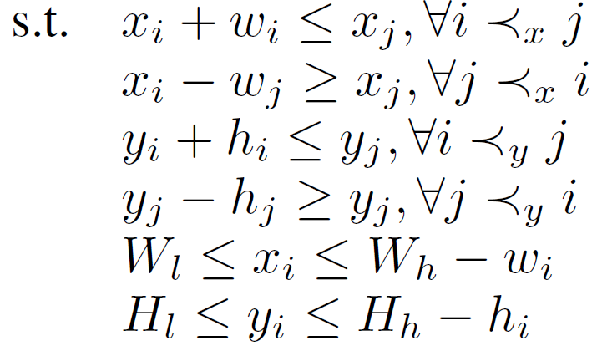


Macro Legalization
Macro legalization can be formulated as following.
($\hat{x}, \hat{y}$)$:$ The coordinates before legalization
($w_{i}, h_{i}$): The width and height of the macro i
$W_{l }(W_{h}):$ the left (right) boundary of the layout
${ H}_{l} (H_{h})$ : the bottom (top) boundary of the layout
i在j的左邊
i在j的下面

Slide 26
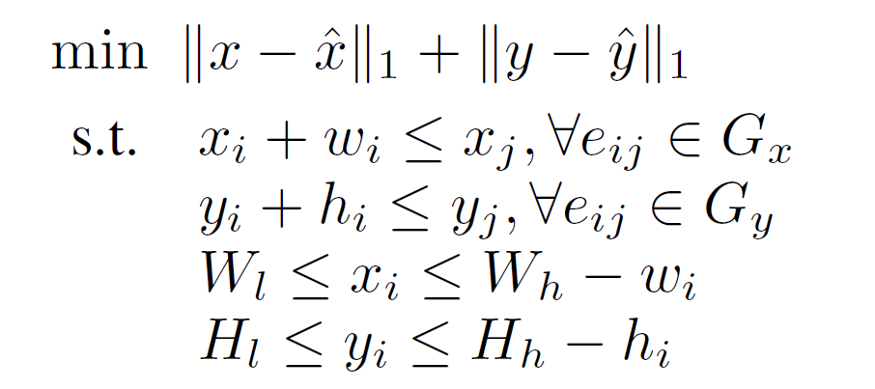
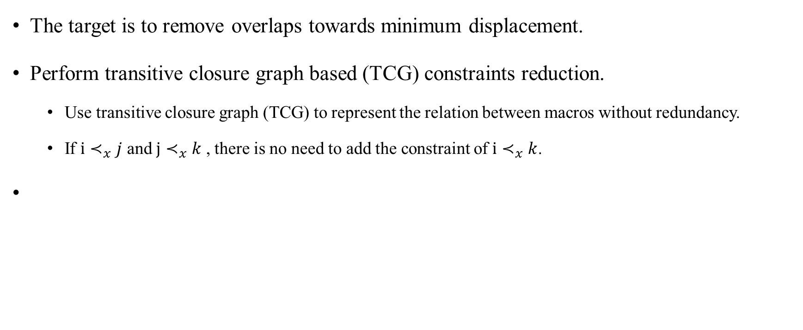
TCG Based Min-Cost Flow Algorithm
The target is to remove overlaps towards minimum displacement.
Perform transitive closure graph based (TCG) constraints reduction.
Use transitive closure graph (TCG) to represent the relation between macros without redundancy.
If $i≺_{x}j$ and $j≺_{x}k$ , there is no need to add the constraint of $i≺_{x}k$.

Slide 27
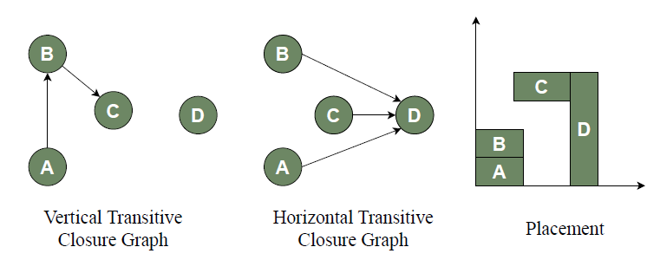

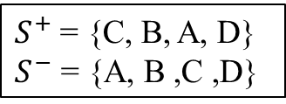
TCG Based Min-Cost Flow Algorithm
To construct the transitive closure graph (take horizontal TCG ($G_{X}$) as example):
Visit the macro by the order of the $S^{+}$.
Add the edge $e_{ik}$to $G_{X}$ if $S^{−}\left(i\right)<S^{−}\left(k\right).$
Must ensure that there is do not exist $e_{ij}$ in $G_{X}$ where $j≺_{x}k.$
$S^{+}$ = {C, B, A, D}
$$S^{−} \text{= \{}\text{A}\text{, }\text{B}\text{ ,}\text{C}\text{ ,}\text{D}\text{\}}$$
Notes:
垂直的:
Visit the macro by the order of the $S^{-}$.
Add the edge $e_{ik}$to $G_{X}$ if $S^{+}\left(i\right)>S^{+}\left(k\right).$

Slide 28
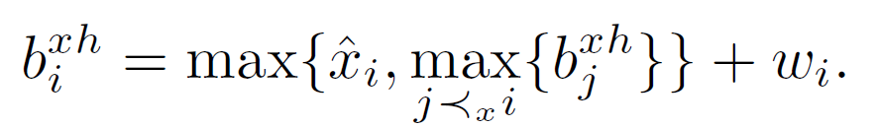
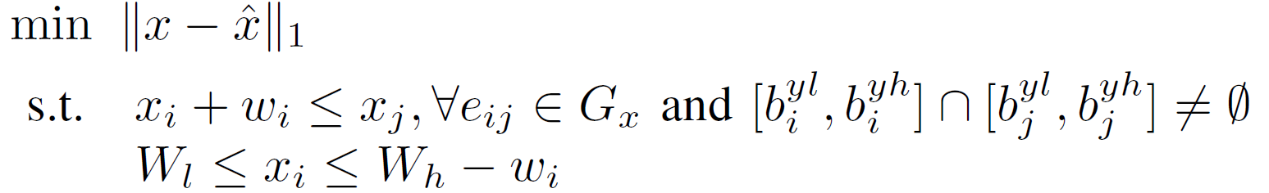
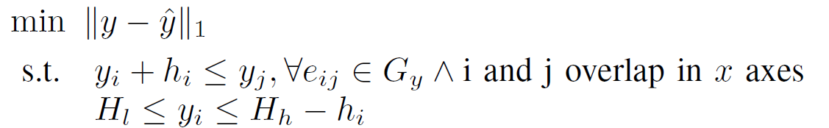
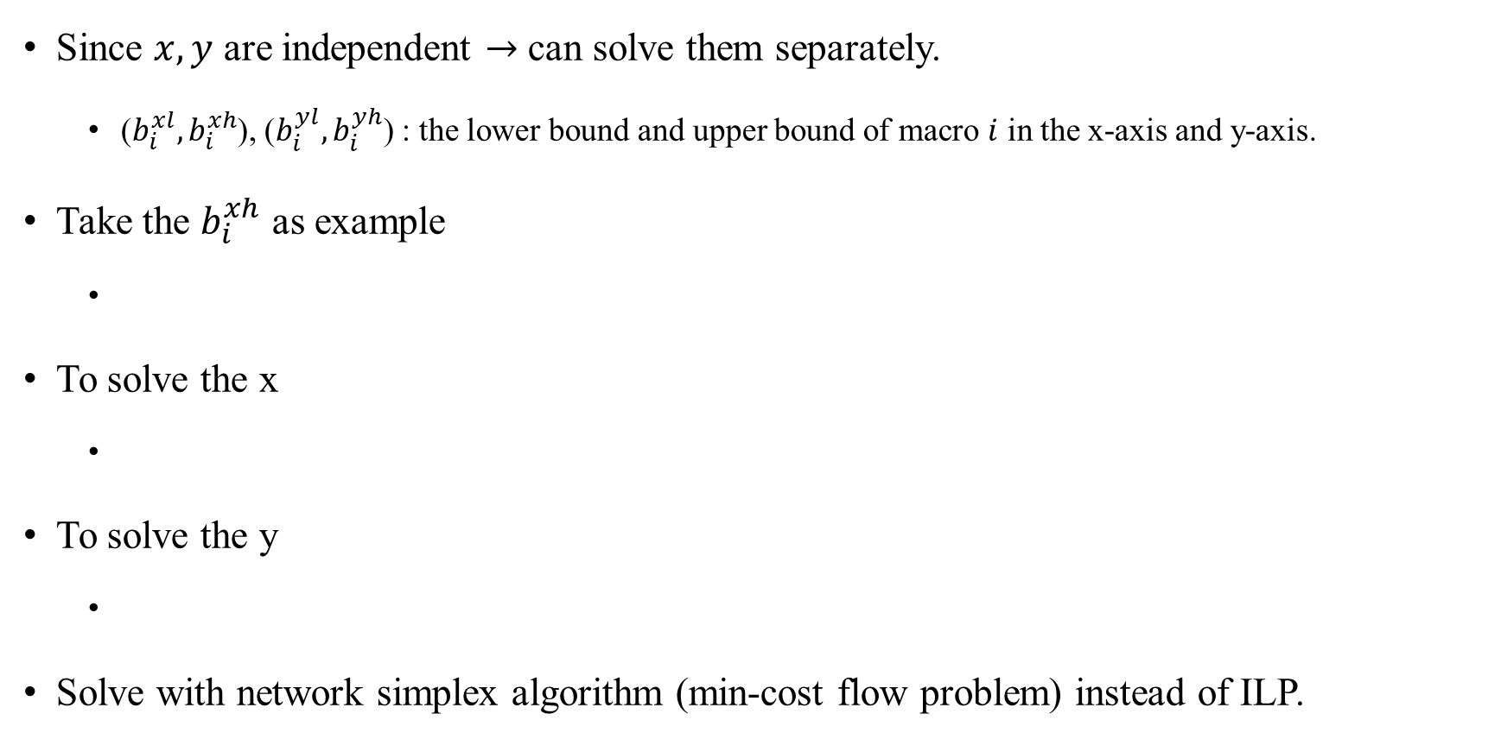
TCG Algorithm
Since $x, y$ are independent $→$ can solve them separately.
($b_{i}^{xl}, b_{i}^{xh}$), ($b_{i}^{yl}, b_{i}^{yh}$) : the lower bound and upper bound of macro $i$ in the x-axis and y-axis.
Take the $b_{i}^{xh}$ as example
To solve the x
To solve the y
Solve with network simplex algorithm (min-cost flow problem) instead of ILP.
Notes:
看是legalization前的位置比較大或是所有在macro i 左邊的macro j 的 x的upperbound比較大，再加上macro i的寬度
因為如果y沒有交集，不需要去考慮x的constraint
因為上一步x已經固定了，所以可以直接考慮x會重疊的範圍，以此來減小複雜度

Slide 29
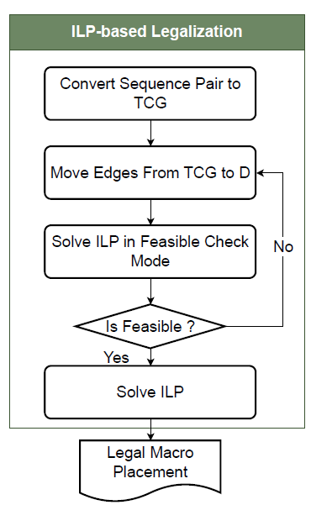
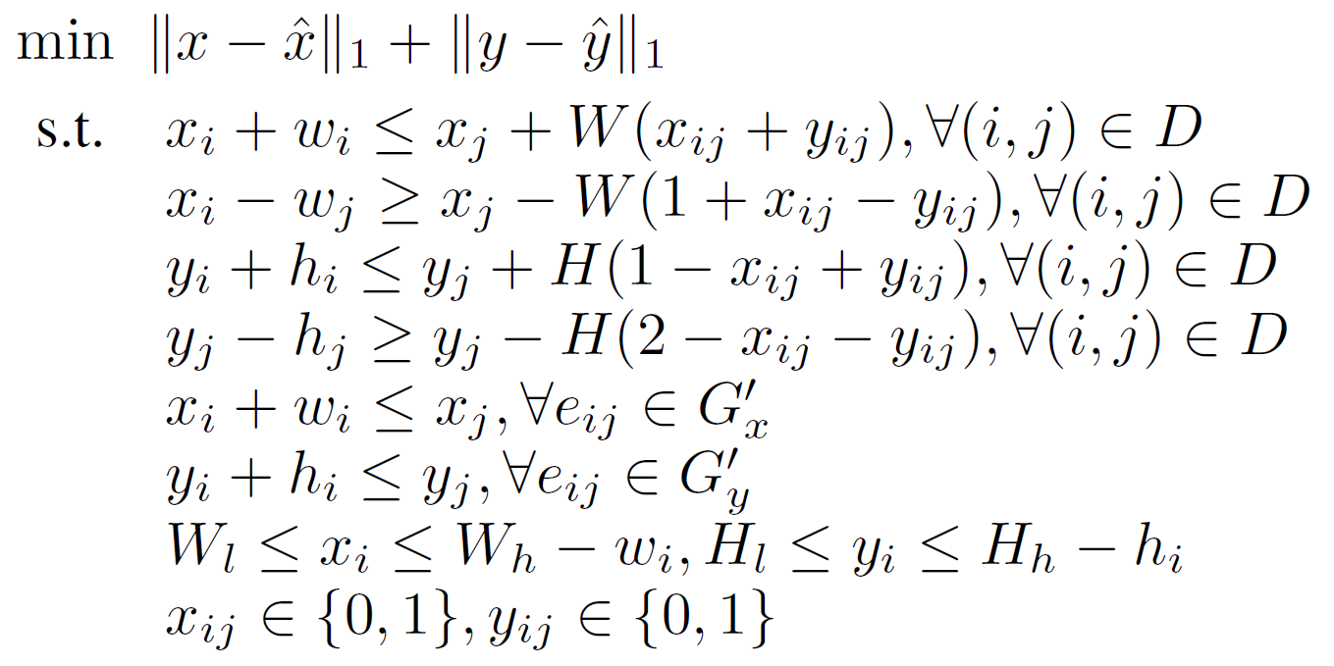

Integer Linear Programming (Infeasible SP)
Let $D$ be the set of macro pairs that in the infeasible sequence pair which needing to change their relative position.
Remove relations in $D$ from TCG and the remaining are unchanged.
Use Gurobi solver.
Notes:
Infeasible sp 可能就是某個macro會超出邊界
Gx’, Gy’: remaining graph

Slide 30
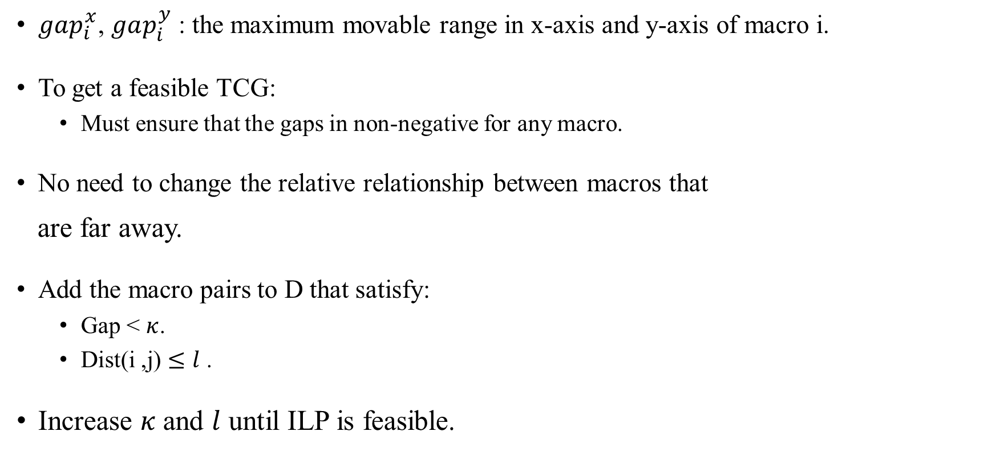
Integer Linear Programming (Infeasible SP)
$gap_{i}^{x}$, $gap_{i}^{y}$ : the maximum movable range in x-axis and y-axis of macro i.
To get a feasible TCG:
Must ensure that the gaps in non-negative for any macro.
No need to change the relative relationship between macros that
are far away.
Add the macro pairs to D that satisfy:
Gap < $κ$.
$\text{Dist}\text{(}\text{i}\text{ ,}\text{j}\text{)}≤l$ .
Increase $κ$ and $l$ until ILP is feasible.
Notes:
*

Slide 31
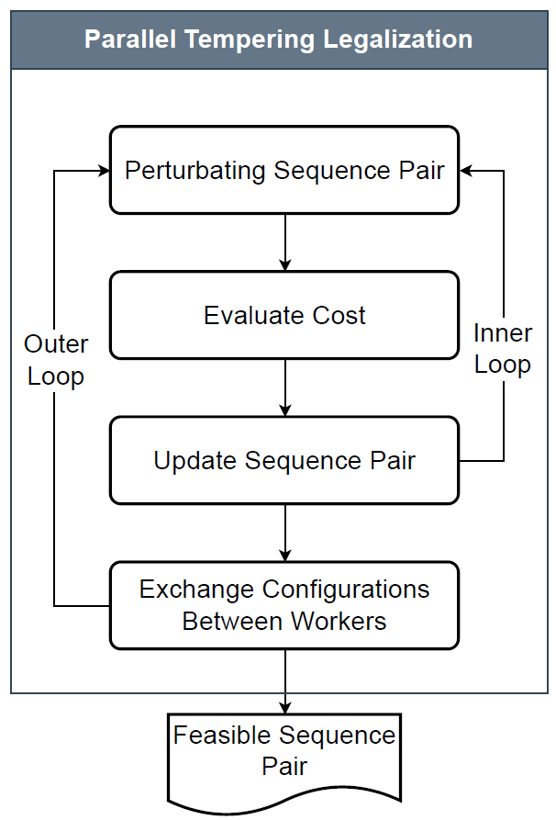
Parallel Tempering Macro Legalization (Infeasible SP)
If the number of macros is too large, will use this method.
Is a population-based algorithm, where each replica is associated
with a different temperature.
Higher temperature represents flatter distribution of states.
In parallel tempering, replicas perform independent searches but
periodically exchange configurations between adjacent temperatures.
Can escape from local minimum.
Notes:
population-based algorithm:群體的算法
目標是要得到valid sequence pair

Slide 32
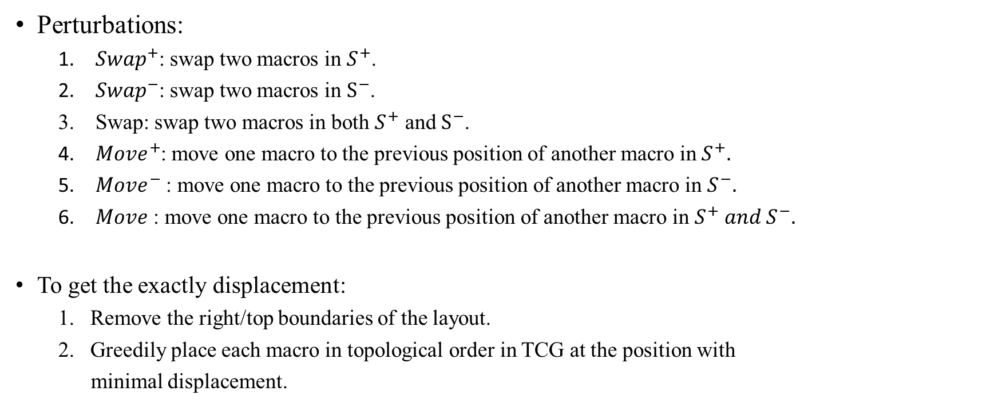
Parallel Tempering Macro Legalization (Infeasible SP)
Perturbations:
${Swap}^{+}$: swap two macros in $S^{+}$.
${Swap}^{−}$: swap two macros in $S^{−}$.
Swap: swap two macros in both $S^{+}$ and $S^{−}$.
${Move}^{+}$: move one macro to the previous position of another macro in $S^{+}.$
${Move}^{−}$ : move one macro to the previous position of another macro in $S^{−}.$
$Move$ : move one macro to the previous position of another macro in $S^{+} and S^{−}.$
To get the exactly displacement:
Remove the right/top boundaries of the layout.
Greedily place each macro in topological order in TCG at the position with
minimal displacement.
Notes:
population-based algorithm:群體的算法
Move+: 在s+中把它移到另一個macro的前一個位置
Exactly: 準確的

Slide 33
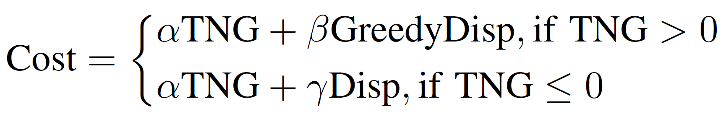

Parallel Tempering Macro Legalization (Infeasible SP)
Cost function
GreedtDisp
obtained displacement via the greedy method.
TNG
The sum of the absolute value of the negative gap of all macros.
Disp
exact displacement by solving min-cost flow.
$α=n\left(W+H\right)$, where n = #macros, (W, H) is the size of the placement area.
$β= γ=1$
Notes:
population-based algorithm:群體的算法
Move+: 在s+中把它移到另一個macro的前面
Exactly: 準確的

Slide 34
Outline
Introduction
Preliminaries
Proposed Algorithm
Previous methods
Barzilai-Borwein Method Enabled Nesterov Algorithm
Macro Legalization
Experimental Result

Slide 35
Experimental Result
NVIDIA GeForce RTX 2080 / 10 cores Intel(R) Xeon(R) Silver 4210R CPU @ 2.40GHz
62 GB of memory / Linux.
Using the framework on top of DREAMPlace.
Implement BB method enabled Nesterov optimizer with PyTorch.
C++ for macro legalization.
Benchmarks
ISPD2005
Modify such that the macros and the I/O pins are free to move without changing their shape.
MMS
Frees all the macros in ISPD2005/ISPD2006 and set the sizes of all I/O objects to zero.
TILOS
Ariane(single core RISC-V CPU).
MemPool.
BlackParrot (many-core RISC-V CPUs with large amounts of on-chip SRAMs).
NVDLA
Notes:
* 2005 可能有fixed的macro

Slide 36
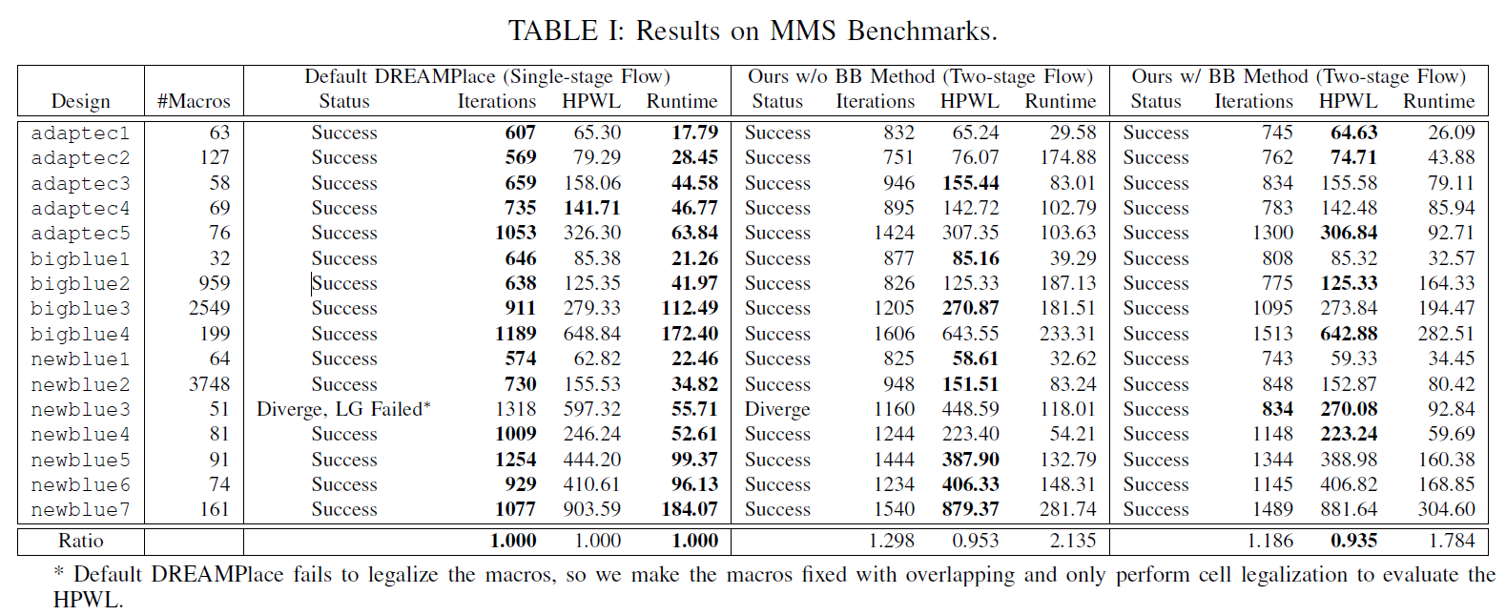



Compared with default DREAMPlace
HPWL: -6.5%
Solve the problem of divergence
Compared with the one w/o BB method
HPWL: -2.4%
Iteration: -9.0%
Notes:
LG: legalization
迭代時間: 找到local minimun的那個咚咚

Slide 37
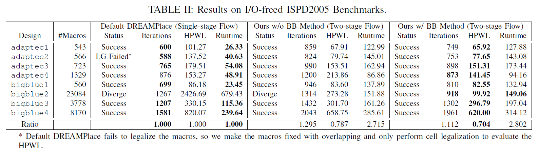



Compared with default DREAMPlace
HPWL: -29.6%
Solve the problem of divergence
Compared with the one w/o BB method
HPWL: -14.1%
Iteration: -14.4%
Notes:
* LG: legalization

Slide 38
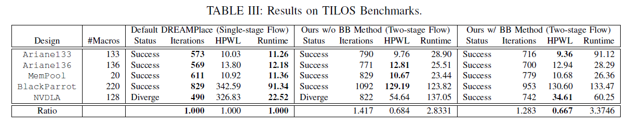



Compared with default DREAMPlace
HPWL: -33.3%
Solve the problem of divergence
Compared with the one w/o BB method
HPWL: -7.7%
Iteration: -9.4%
Notes:
* LG: legalization

Slide 39
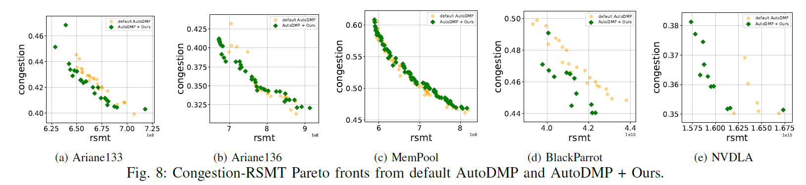
Experimental Result - Integration into AutoDMP
Linux machine with 4 NVIDIA GeForce RTX 2080Ti.
Two 20 cores Intel(R) Xeon(R) Gold 6230 CPU@ 2.10GHz / 500 GB of memory.
Running AutoDMP for 400 iterations.
AutoDMP has the option to choose between Adam optimizer and Nesterov optimizer at runtime.
The author changes the Nesterov optimizer with BB method enabled Nesterov.
Objective: RSMT, Congestion, and density.
Notes:
* 可以發現ariane133, blackparrot及nvdla 都有不錯的imporvement.

Slide 40
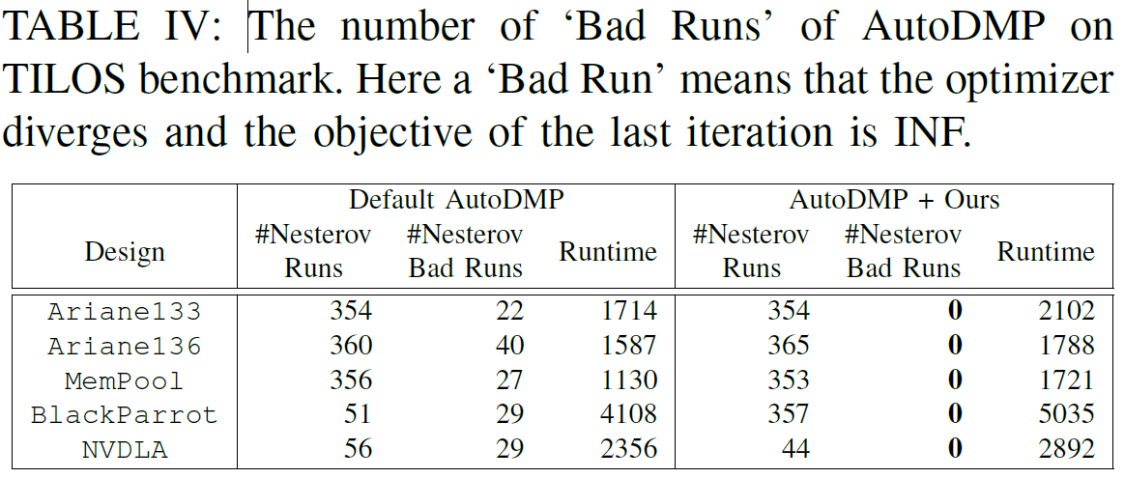
Experimental Result - Integration into AutoDMP
Bad run: the optimizer diverges in the last iteration, and make the objective INF.
BlackParrot: the number of Nesterov increased a lot after BB method is enabled, which means that BB method makes Nesterov perform better than Adam on this design.
Notes:
可以發現ariane133, blackparrot及nvdla 都有不錯的imporvement.
在具體設計BlackParrot中，啟用BB方法後，Nesterov的次數明顯增加，這意味著BB方法提高了Nesterov在這個特定設計上的性能，使其相對於Adam更能有效地避免發散。这可能是因為BB方法有助於考慮更高階的信息，提高了Nesterov優化器在特定場景中的效能。

Slide 41
Thank you for listening!

